Slide 1
ABOUT JAVA
Java is a general purpose, high-level programming language developed by Sun Microsystems.
PROGRAMS EXECUTION::: The source code of java is compiled into a format called byte code (Having Extension .class), which can be executed by java interpreter. Compiled java codes can be run on most of the computers. Because java interpreters are available for most of the operating systems.

Slide 2
HISTORY
Java history is interesting to know. The history of java starts from Green Team. The small team of sun(sun microsystems) engineers called Green Team. . Java team members , initiated a revolutionary task to develop a language

Slide 3
Why Java Named so???
) Firstly, it was called "Green talk" by James Gosling and file extension was .gt.
After that, it was called Oak and was developed as a part of the Green project.
The team gathered to choose a new name. Since java was so unique, most of the team members preferred java.
Java is an island of Indonesia where first coffee was produced (called java coffee).
Actually, They wanted something that reflected the essence of the technology.

Slide 4
Features Of Java
Syntax is very simple.
No need to remove unreferenced objects because there is Automatic Garbage Collection in java.
Java code can be run on multiple platforms e.g. Windows, Linux, Sun Solaris, Mac/OS etc. Java code is compiled by the compiler and converted into bytecode. This bytecode is a platform-independent code because it can be run on multiple platforms i.e. Write Once and Run Anywhere(WORA).
There are lack of pointers that avoids security problem.

Slide 5
APPLICATION AREAS OF JAVA
If you want to see where Java is used, you are not too far away. Open your Android phone and any app they are actually written in Java programming language.
Many useful software and development tools are written and developed in Java.
Currently, Java is used in internet programming, mobile devices, games, e-business solutions etc.

Slide 6
Project - MISHMASH
INTRODUCTION::::
My Project, consists of three modules :
GIF Player
Media Player
PDF Reader
GIF-(Graphics Interchange Format ).It is an image format that was developed by software writer Steve Wilhite . It has extension .gif.
Media Player-Software that plays Audio , Video files in a system.
PDF-(Portable Document Format). It was introduced to ease the sharing of documents between computers and across operating system platforms.

Slide 7
SPECIFICATIONS of Project:::
FRONT
JMF(Java Media Framework) is needed to run Media Player.
Module of Media Player is 32-bit Compatible.
It can work for only Mp3 and MPEG files.
BACK
Class Jfilechooser is used in these modules to choose file from the system.
Jpedal library is used to run PDF Reader.
Theoretical knowledge of java is needed.

Slide 8
Guide For Execution of Project
CLICK ON ‘IN’
CHOOSE ANY OF THREE OPTIONS
MEDIA PLAYER
GIF PLAYER
PDF READER
PLAYER
ENTER NAME OF GIF
LET’Z START
CHOOSE ANY VALID FORMAT FILE
CLICK ON ‘RUN ENTERED FILE’
CHOOSE MP3 FILE

Slide 9
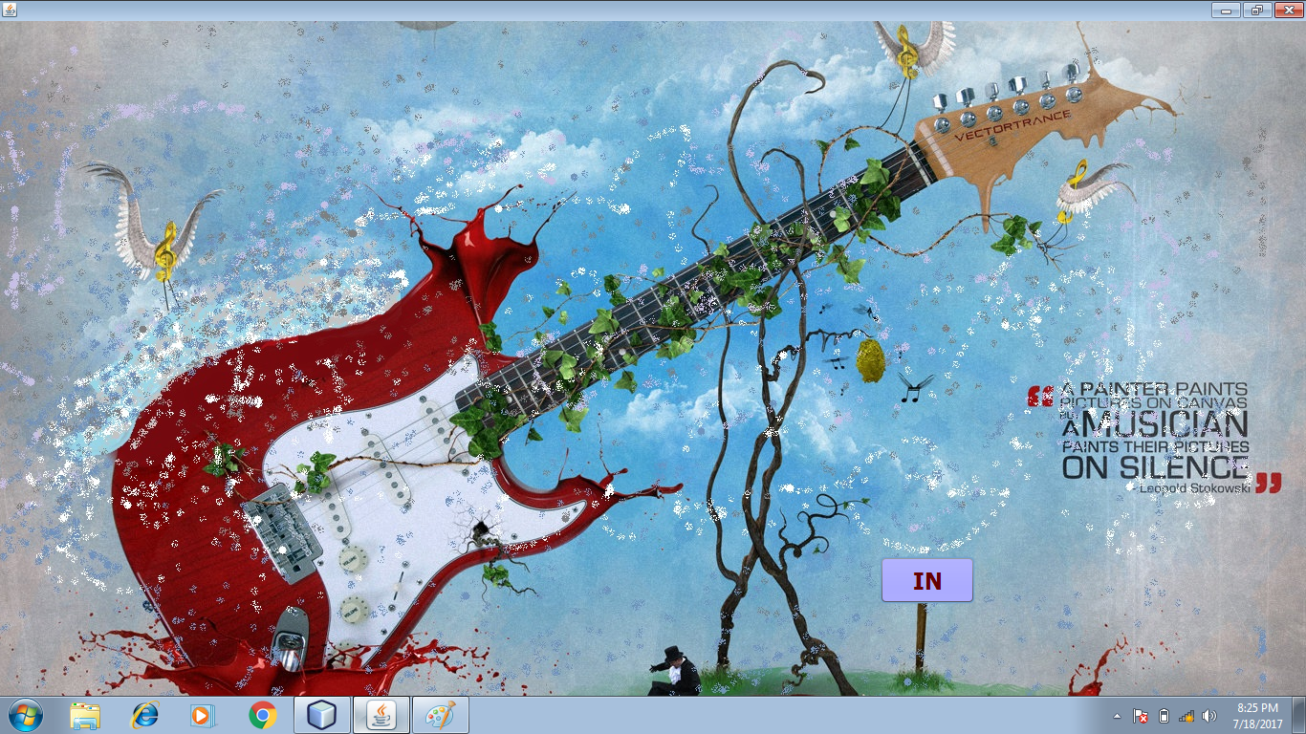
1)Entrance to project..

Slide 10
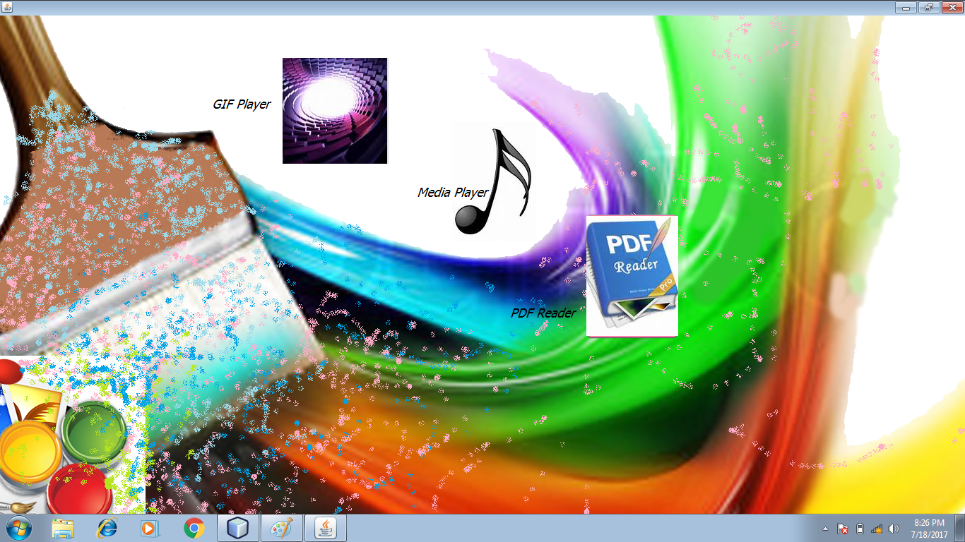
2) Choose one of three..

Slide 11
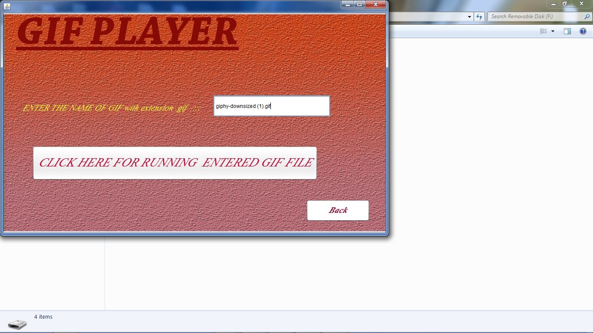
3)GIF Player chosen..

Slide 12
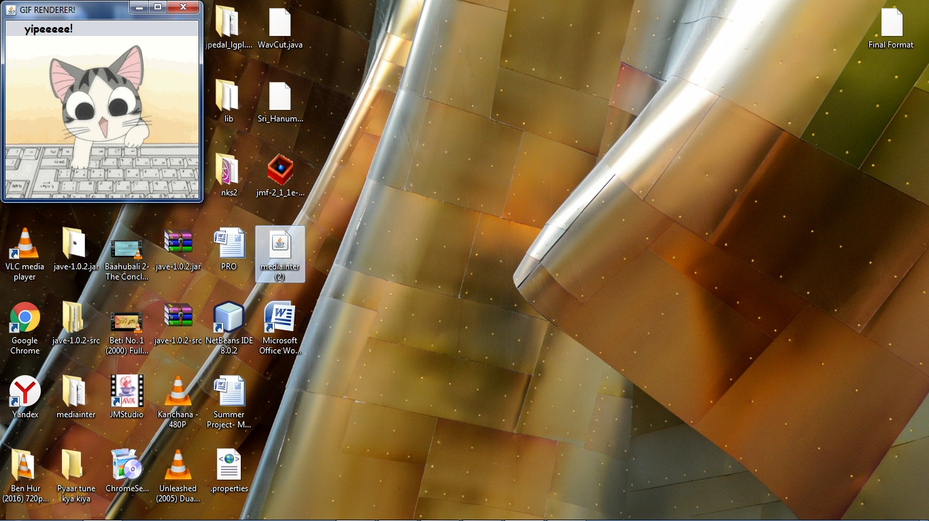
4) It’s working ☺

Slide 13
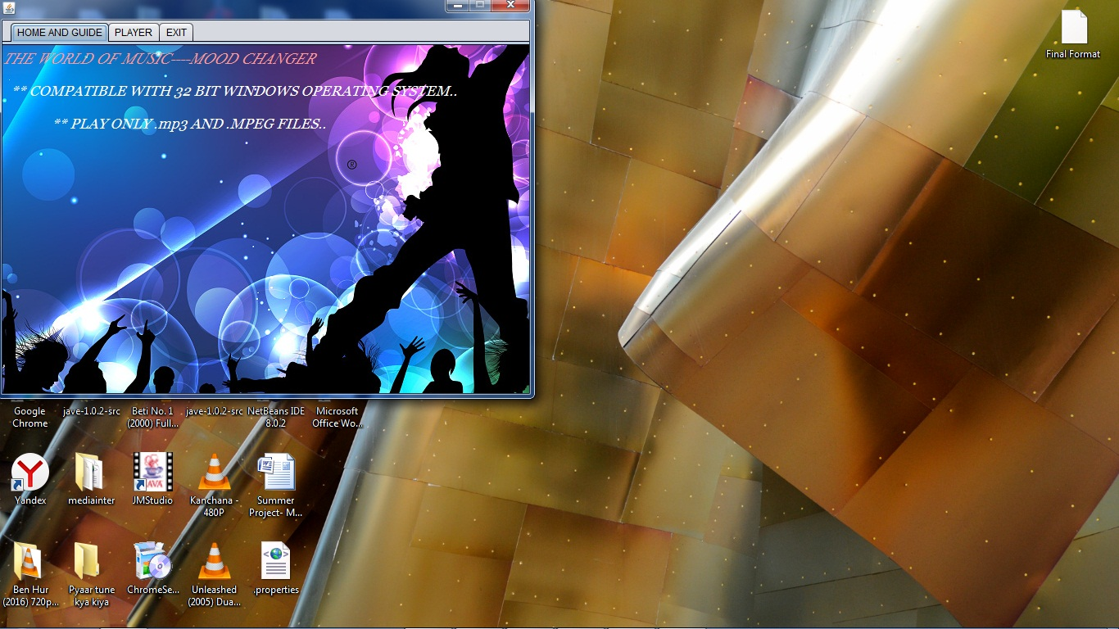
5) Mp3 Player chosen..

Slide 14
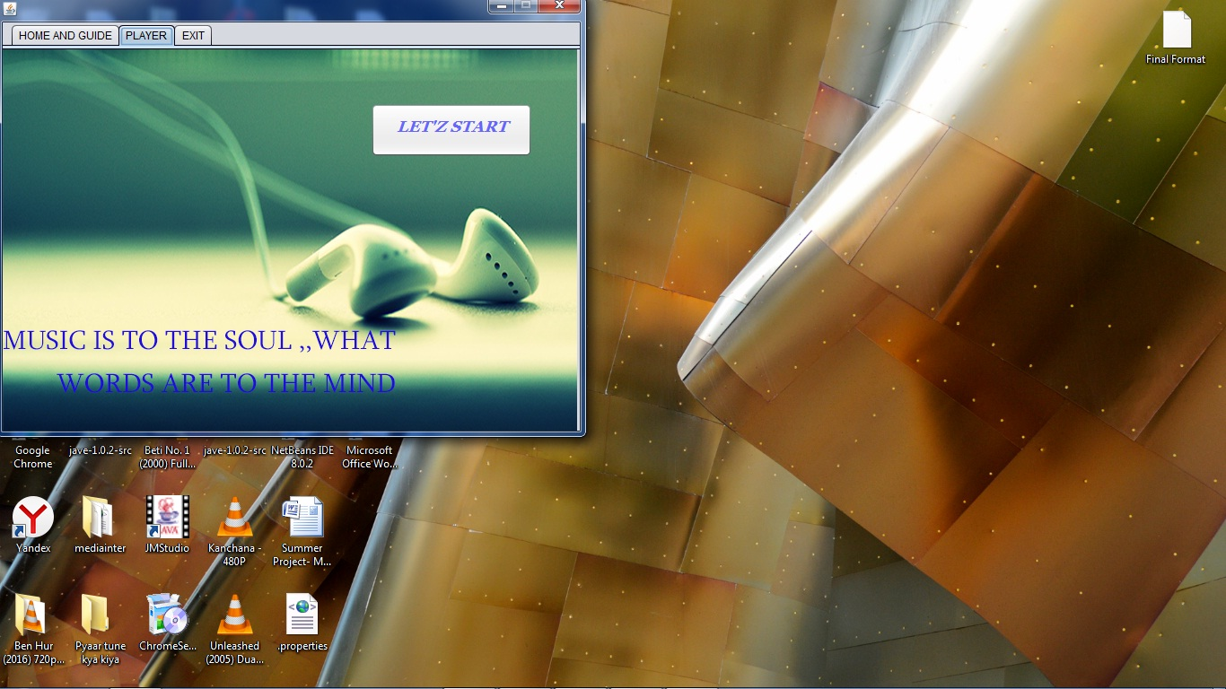
6) Second tab (Player) is chosen..

Slide 15
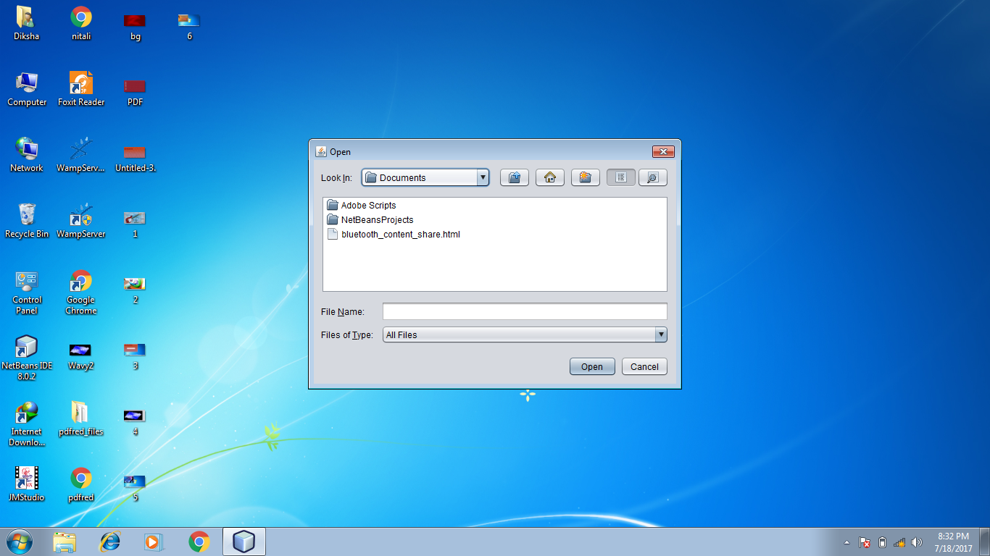
7)Choose Mp3 File..

Slide 16
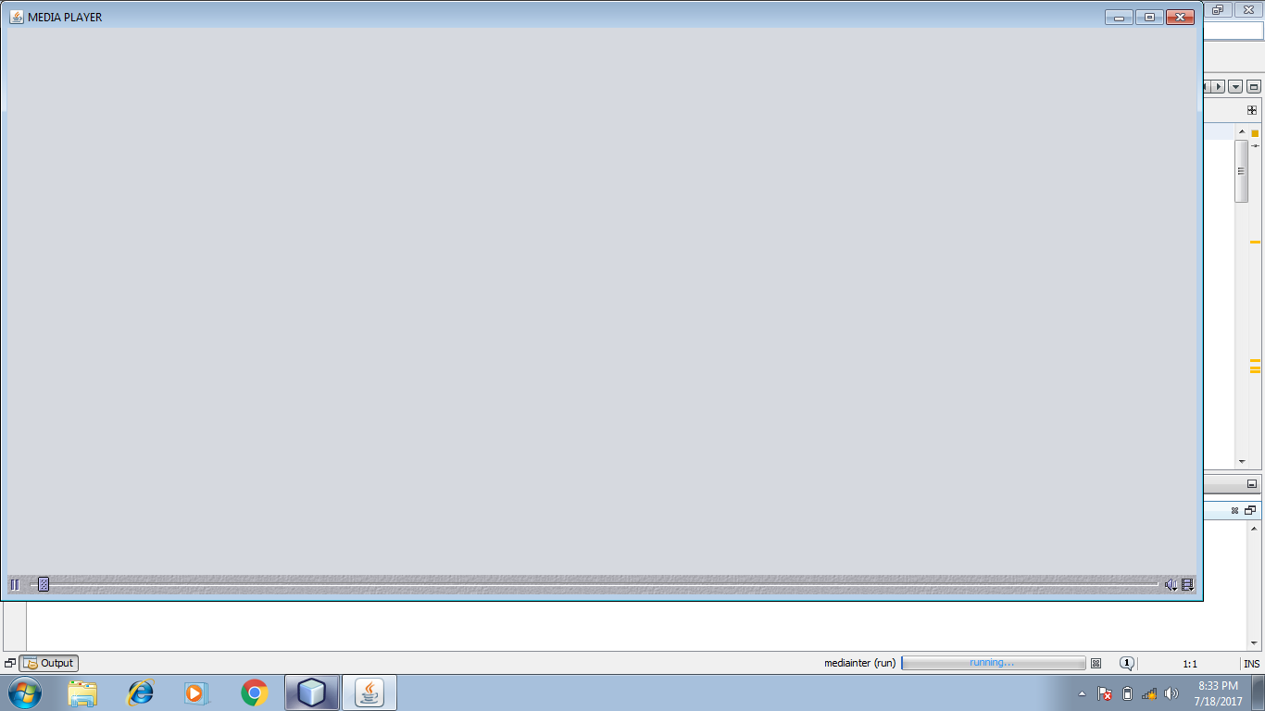
8) Workingggg…

Slide 17
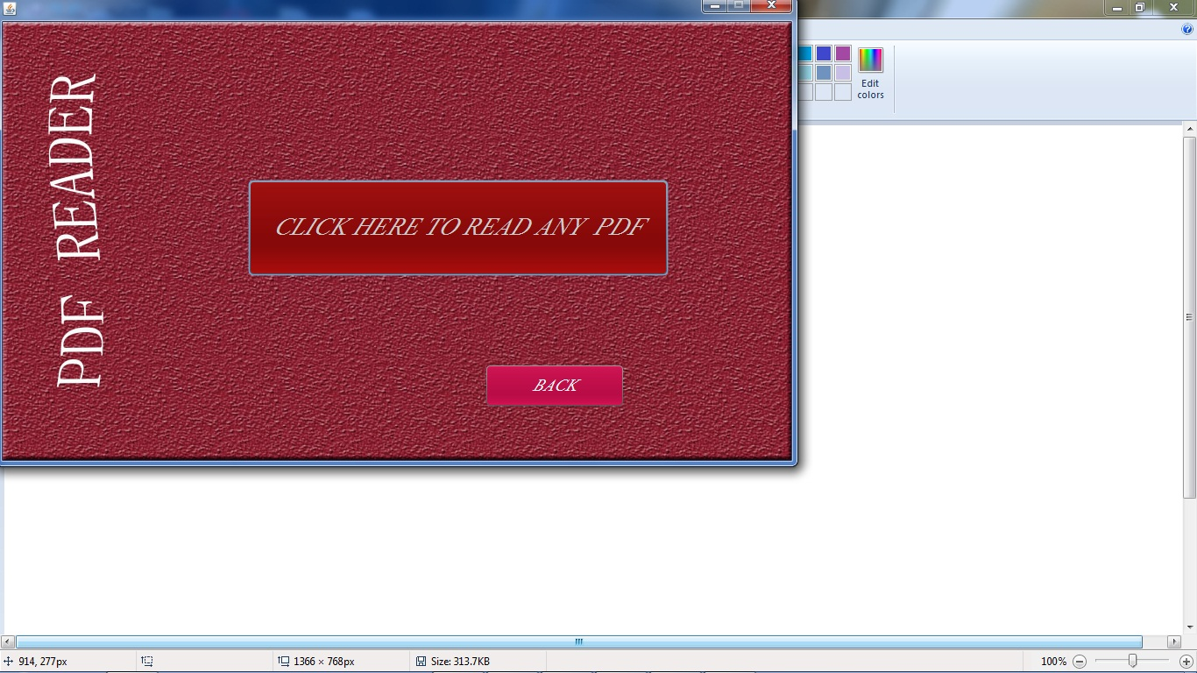
PDF Reader chosen..

Slide 18
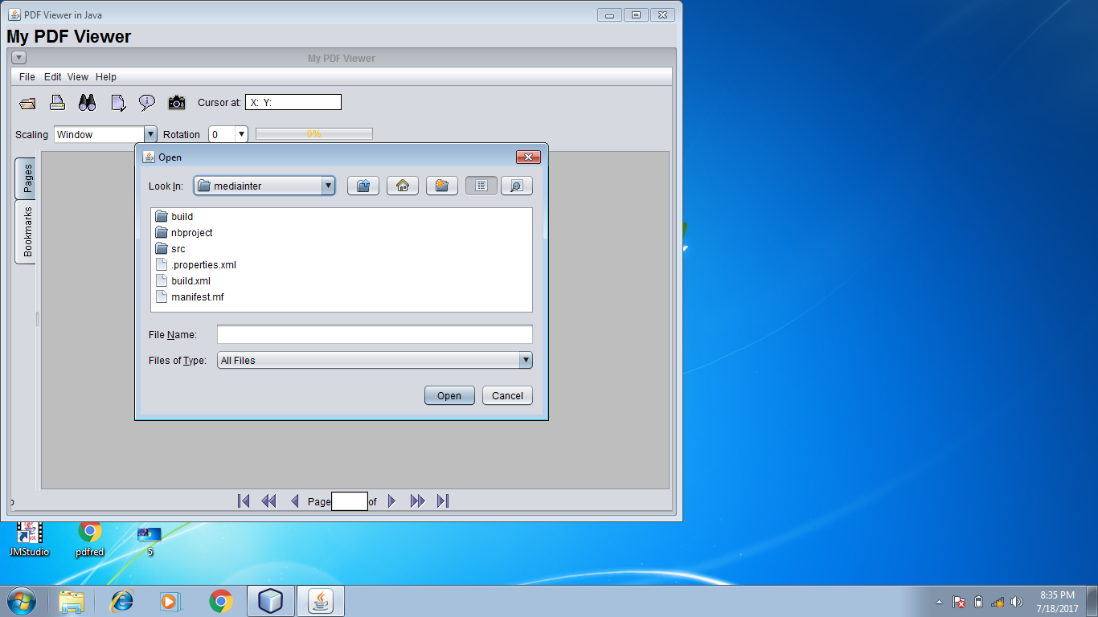
Choose Valid Format File..

Slide 19
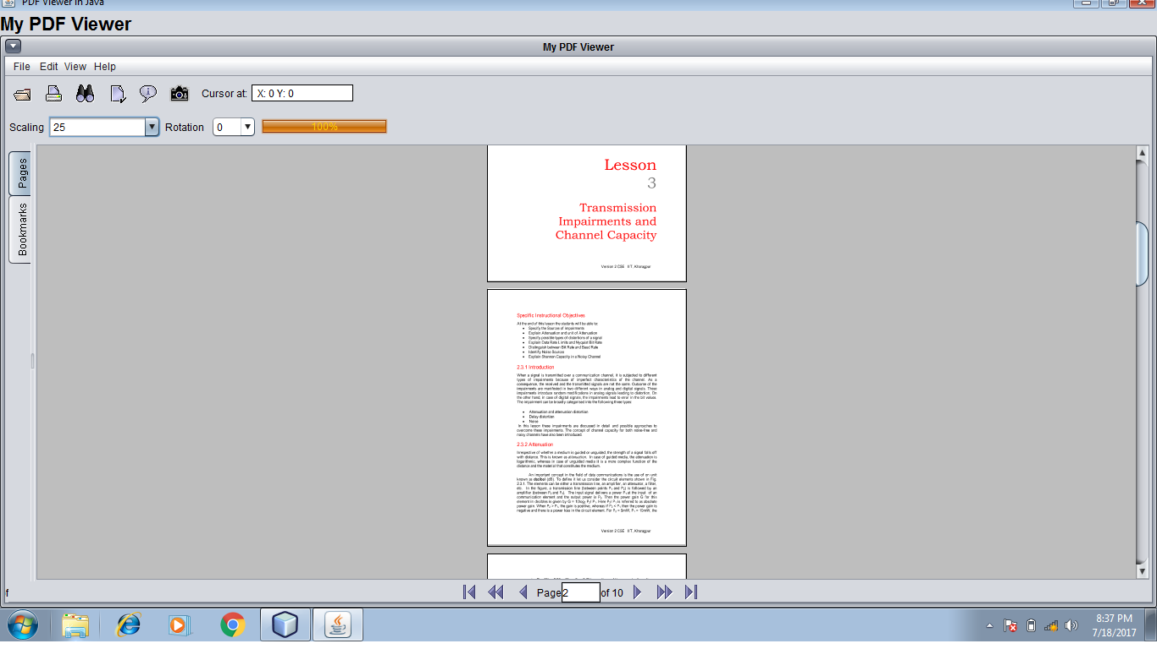
Yesss!!!! It’s Working…..

Slide 20
Achievement of goal…
I had a desire to combine some applications to make one software, so that user can do more works with only one software.(No Need To Download Separate Applications). I chose three modules mentioned before.
In the module of Media Player I first made the code by myself but it was erroneous, then my trainer (Respected, Ms. Prerna Grover ) helped me to find and remove those errors.
But in other two modules I did my Project myself.

Slide 21
THANK YOU!!!!!!!!

